Slide 1



Intelligent Agents
Artificial Intelligence
Rachid Anane 2013 / Mark Tyers 2016

Slide 2
Outline
Definition of AI
AI models
AI examples
Eliza
AI Classification

Slide 3
Definition of AI
AI can be determined by
a set of goals
a class of problems
a set of methods.

Slide 4
AI - A Set of Goals
“The automation of activities that we associate with human thinking, such as decision making, problem solving, learning.” [Bellman 1978]
“The art of creating machines that perform functions that require intelligence when performed by a human” [Kurweil 1990]
“The study of computations that make it possible to perceive, reason and act” [Winston 1992]
“The branch of computer science that is concerned with the automation of intelligent behaviour” [Luger & Stubblefield 1993]

Slide 5
AI Models
These different views of AI fall into four categories:
Systems that think like humans
Systems that act like humans
Systems that think rationally
Systems that act rationally

Slide 6
AI Models
Share the underlying assumptions that humans are a good source of clues about how to build an intelligent machine.
Theories of intelligence should be tested by implementing them in computer programs and testing them on real programs.

Slide 7
Systems that Think Like Humans
Must determine how humans think – need to get inside the actual workings of the human mind through
Introspection
Psychological experiments
With a precise theory of how the mind works, then it is possible to express the theory as a computer program.
Example: ‘General Problem Solver’ by Newell and Simon (1961) (common sense)

Slide 8
Cognitive Science
New discipline
Combines:
Computer models from AI
Experimental techniques from Psychology.

Slide 9
Systems that Act Like Humans
Turing Test: The Imitation Game
Operational test for intelligent behaviour:
i.e. ability to achieve human-level performance in all cognitive tasks
sufficient to fool a human interrogator.

Slide 10
Capabilities
Natural language processing
Knowledge representation
Automation reasoning (to use information to answer questions etc.)
Machine learning

Slide 11
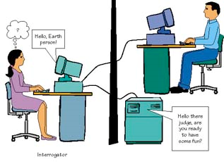
Turing Test

Slide 12
Total Turing Test
Includes:
Linguistics
Robotics
To pass, the computer will also need
Computer vision (to perceive objects)
Robotics (to move about)

Slide 13
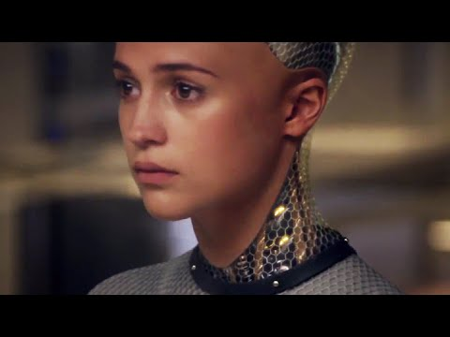

Slide 14
Systems that Think Rationally
Thinking rationally: based on laws of thought which are supposed to govern the operation of the mind – logic
E.g predicate calculus,
What are correct arguments/thought processes?
Aristotle’s syllogisms provide patterns argument structures, that always gave correct conclusions given correct premises:
e.g. Socrates is a man; all men are mortal; therefore Socrates is mortal.

Slide 15
Problem with Thinking Rationally
It is difficult to take informal knowledge and state it in formal terms (required by logical notation)
Solving a problem in principle is different from solving it in practice (e.g. limitations of computational resources)
Uncertainty is difficult to take into consideration.

Slide 16
Systems that Act Rationally
Rational behaviour: doing the ‘right thing’
The right thing: that which achieves one’s goals given one’s beliefs, or, that which is expected to maximise goal achievement, given the available information.
Does not necessarily involve thinking (e.g blinking reflex) but thinking should be at the service of rational action.
An agent may require thinking rationally to decide which action will achieve one’s goal.
More general than the laws of thought approach.

Slide 17
Characteristics of Acting Rationally
A rational agent’s degree of intelligence might be characterised by:
ability to act rationally in a variety of circumstances
ability to adopt complex goals and balance their achievement
ability to adapt to new circumstances

Slide 18
Classes of Problems
Problems that require search
Problems that are poorly specified

Slide 19
Problems that Require Search
no deterministic algorithm is known
must use “trial and error”
NP-hard problems all have this property
e.g. scheduling courses as opposed to sorting a class

Slide 20
Problems That are Poorly Specified
We do not have a concise, exact problem specification
We don't know what knowledge is needed to solve it
We don't have the knowledge needed to solve it
Our knowledge is imprecise and inaccurate
e.g. explain integration to a human as opposed to factoring an integer

Slide 21
A Set of Methods
Use of general inference methods
such as heuristic search,
or resolution theorem proving
Representation of knowledge in declarative form
such as search spaces
or systems of logical axioms

Slide 22
Example: IBM Deep Blue
Chess Playing
Perception: advanced features on the board
Actions: choose a move
Reasoning: heuristics to evaluate board positions, search

Slide 23
Example: Microsoft Pathfinder
Medical Diagnosis
Perception: symptoms, test results
Actions: suggests tests, make diagnosis
Reasoning: Bayesian inference, machine learning, simulation

Slide 24

AlphaGo
British AI Company
Acquired by Google in 2014
AI system powered by Google / DeepMind
Beat world champion Go player 4-1
March 2016

Slide 25
Example: Eliza (1966)
ELIZA (Weizenbaum, 1966)
An early AI program that simulated the behaviour of a therapist.
ELIZA’s knowledge of both English and psychology was coded in a set of simple rules.

Slide 26
Person: Men are all alike.
ELIZA: In what way?
Person: They’re always bugging us about something or other.
ELIZA: Can you think of a specific example?
Person: Well, my boyfriend made me come here.
ELIZA: Your boyfriend made you come here.
Person: He says, I’m depressed much of the time.
ELIZA: I m sorry to hear you are depressed.
Person: It’s true. I am unhappy.
ELIZA: Do you think coming here will help you not to be unhappy?
Person: I need some help, that much seems certain.
ELIZA: What would it mean to you if you got some help?
Person: Perhaps I could learn to get along with my mother.
ELIZA: Tell me more about your family.

Slide 27
Person: Men are all alike.
ELIZA: In what way?
Person: They’re always bugging us about something or other.
ELIZA: Can you think of a specific example?
Person: Well, my boyfriend made me come here.
ELIZA: Your boyfriend made you come here.
Person: He says, I’m depressed much of the time.
ELIZA: I m sorry to hear you are depressed.
Person: It’s true. I am unhappy.
ELIZA: Do you think coming here will help you not to be unhappy?
Person: I need some help, that much seems certain.
ELIZA: What would it mean to you if you got some help?
Person: Perhaps I could learn to get along with my mother.
ELIZA: Tell me more about your family.

Slide 28
ELISA-Like Rules
Some ELIZA-like rules
(X me Y) → (X you Y)
(I remember X) → (Why do you remember X just now)
(My {family-member} is Y) → (Who else in your family is Y)
(X {family-member} Y) → (Tell me more about your family)

Slide 29
Classifying Machine Learning/AI
Classic AI (Watson)
Simple neural network (Deep Learning)
Biological neural network (HTM)

Slide 30

Classic AI
Uses rules defined by subject experts
Programmed by/with subject experts
Answers questions
Examples:
Elisa
IBM Watson

Slide 31

Simple Neural Networks
Uses large datasets
Learning derived from labelled databases
Learns to classify information (NUJ)
Examples:
DeepMind
PyBrain

Slide 32
Artificial Neural Networks
Based on the human brain
Represents information using sparse distributed representations (SDR)
Essential for semantic generalization and creativity
Continuous learning and pattern recognition
Two ANN topologies:
Feedforward
Feedback

Slide 33
ANN Learning Strategies
Supervised learning
System guesses, then corrected by expert
Unsupervised learning
No sample dataset with correct answers
Reinforcement learning
Decisions based on observing environment

Slide 34
PyBrain Tutorial
http://pybrain.org/docs/

Slide 35
Summary
We have covered:
Definition of AI
AI models
AI examples
Eliza
AI classification

Slide 36
References
http://numenta.com/blog/machine-intelligence-machine-learning-deep-learning-artificial-intelligence.html
http://www.tutorialspoint.com/artificial_intelligence/artificial_intelligence_neural_networks.htm

